Slide 1


Theory of Computation: A Problem-Solving Approach
Chapter – 4: Regular Languages and Expressions

Slide 2
Learning Objectives
Learn what is a formal language and how it is related to an automaton.
Learn to construct simple regular expressions.
Learn to convert a regular expression to an equivalent automaton.
Learn to convert an automaton to a regular expression.
Learn a method to compare two regular expressions to determine their equivalence.
Learn to construct regular expressions for user data validation.

Slide 3
The Idea of Formal Languages
A set of strings
Over a set of known symbols called the alphabet
Can be an infinite set
No limit on length of strings in infinite languages
Membership defined by rules: grammar
Languages of finite automata: Regular languages
Complement of a language: set of all rejected strings
Concise way of defining a regular language: Regular Expression
Often abbreviated as RegEx

Slide 4
Regular Expressions
A Regular Expression (RegEx) is defined recursively as:
Any symbol from the alphabet
The null symbol λ
e₁ + e₂ where e₁ and e₂ are regular expressions; the + operator represents set union
e₁.e₂ the . operator stands for concatenation
(e₁)
e₁* the * operator, also known as closure stands for repeated concatenation zero or more times
Any expression obtained by composing any of the above operators applied in any order a finite number of times is also a regular expression.

Slide 5
RegEx Definition: Example
a + b stands for the set of two strings or the language {a, b}
a.b stands for the set containing a single string {ab}
a* stands for {λ, a, aa, aaa, aaaa, …}
(a + b)* stands for {λ, a, b, aa, ab, ba, bb, aaa, aab, …}

Slide 6
RegEx: Example 4.1
Even numbers
(0 + 1)*.0
Sometimes, we omit the concatenation operator and write
(0 + 1)*0

Slide 7
RegEx: Example 4.2
Begin with at least two a s
End with an even number of b s
a.a.(a)*.(b.b)*
or
aaa*(bb)*

Slide 8
RegEx: Example 4.3
Begin with a s
End with b s
Total length is even
(aa)*(bb)* + a(aa)*b(bb)*

Slide 9
RegEx: Example 4.4
Binary strings with exactly one pair of consecutive 0 s
(1 + (01))*00(1 + (10))*

Slide 10
RegEx: Example 4.5
Fifth symbol from the end is a 0
(0 + 1)*.0.(0 + 1).(0 + 1).(0 + 1).(0 + 1)

Slide 11
RegEx: Example 4.6
Binary strings having no more than two 0 s, i.e.,
Having no 0 at all.
Having exactly one 0.
Having exactly two 0 s.
1* + 1*.0.1* + 1*.0.1*.0.1*
or
1*(λ + 0.1*(λ + 0.1*))

Slide 12
RegEx: Example 4.7
Length of the string is a multiple of 3
(aaa + aab + aba + abb + baa + bab + bba + bbb)*
Factoring out common sub-expressions results in a much more concise and elegant RegEx for this language:
((a + b).(a + b).(a + b))*

Slide 13
RegEx: Example 4.8
At least one a and at least one b
(a + b + c)*.a.(a + b + c)*.b.(a + b + c)* +
(a + b + c)*.b.(a + b + c)*.a.(a + b + c)*

Slide 14
RegEx: Example 4.9
L = {uvw | u, w belong to ∑* and |v| = 2} where ∑= {a,b}
(a + b)*(a + b)(a + b)(a + b)*

Slide 15
RegEx: Example 4.10
What is the language of the RegEx:
((aa)*b(aa)*) + (a(aa)*ba(aa)*)
The set of all strings that contain exactly one b and an even number of a s on either side of b or the set of all strings that contain exactly one b and an odd number of a s on either side of b
Thus, the language is merely the set of all strings over {a, b} that contain exactly one b and an even number of a s.

Slide 16
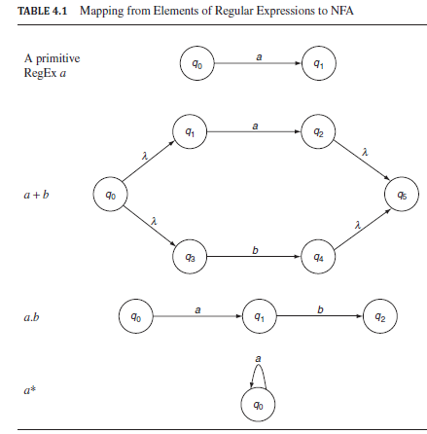
RegEx to NFA

Slide 17
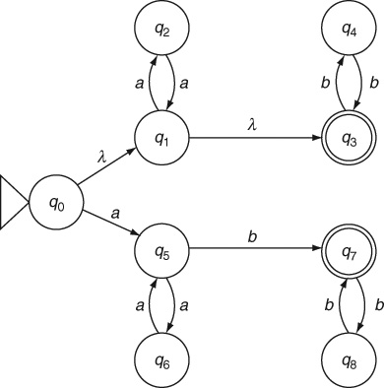
RegEx to NFA: Example 4.11
Convert to an automaton: (aa)*(bb)* + a(aa)*b(bb)*
The given RegEx is in fact: ((a.a)*.(b.b)*) + (a.(a.a)*.b.(b.b)*)

Slide 18
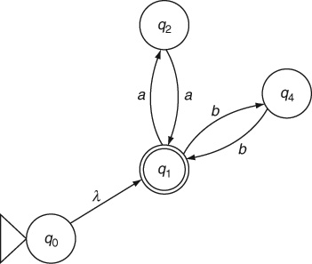
Example 4.11: Why is this wrong?

Slide 19
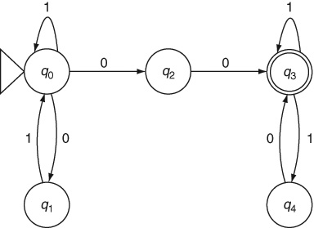
RegEx to NFA: Example 4.12
Convert to an automaton: (1 + (01))*00(1 + (10))*

Slide 20
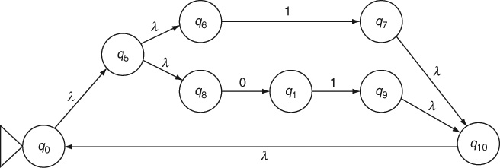
RegEx to NFA: Example 4.12
Partial NFA before simplification

Slide 21
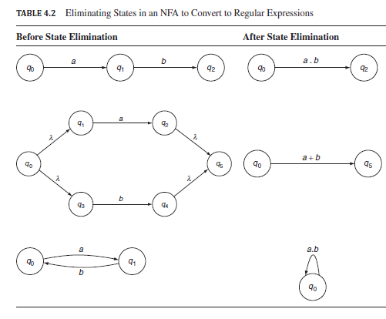
DFA to RegEx: State Elimination
Use of Generalized Transition Graphs with RegEx as labels of transitions

Slide 22
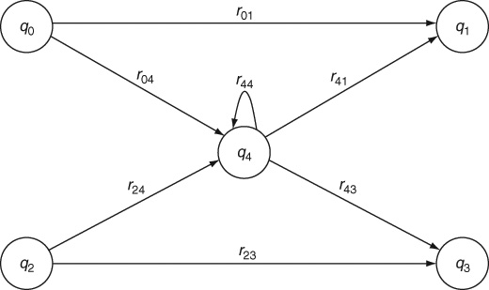
State Elimination: General Configuration

Slide 23
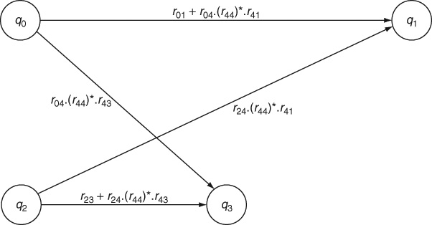
After Eliminating q₄

Slide 24
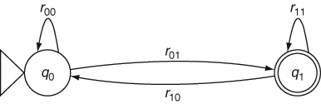

Possible Final Configuration
The resulting RegEx is:

Slide 25
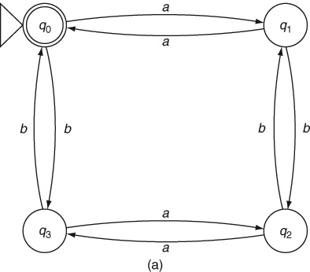
DFA to RegEx: Example 4.13
Even number of a s and even number of b s

Slide 26
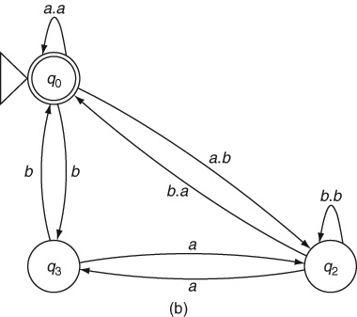
Example 4.13: After Eliminating q₁

Slide 27
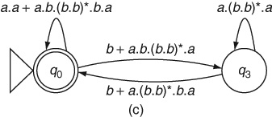
Example 4.13: After Eliminating q₂

Slide 28
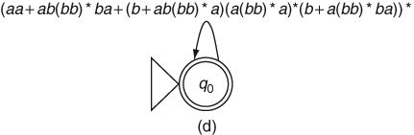
Example 4.13: After Eliminating q₃
The final RegEx is:
(aa + ab(bb)*ba + (b + ab(bb)*a)(a(bb)*a)*(b + a(bb)*ba))*

Slide 29
Comparing RegEx’s or Automata
E.g., (0 + 1)*0 and 1*0(0 + 11*0)*
Convert RegEx to NFA, then to DFA
Treat the two DFAs together as a single machine for a moment with their two start states being reachable from a new start state through λ-transitions.
Mark all distinguishable states.
If the two start states are marked as distinguishable, then the two automata are different.
If the two start states are indistinguishable, then the two machines are equivalent

Slide 30
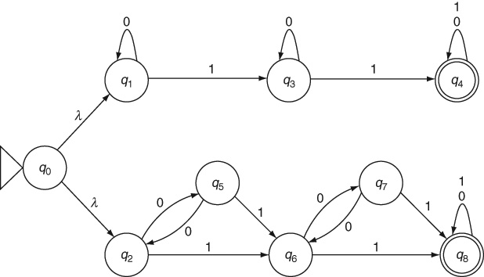
Comparing RegEx’s: Example 4.14
These two RegEx’s are the same:
0*10*1(0 + 1)* and
((00)*1 + 0(00)*1) ((00)*1 + 0(00)*1)(0 + 1)*

Slide 31
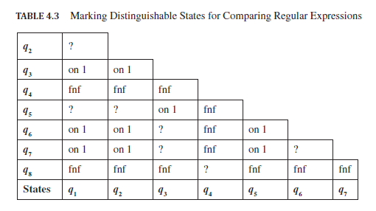
Example 4.14: Table Filling for Marking

Slide 32
Mantras for Constructing a RegEx
What is the simplest string in the language?
What are some other strings in the language?
What are all the other strings in the language?
Is the null string a member of the given language?
With what symbols can strings in the language begin and end?
What does an equivalent automaton need to remember?
What is the complement of the language?

Slide 33
Mantras for Constructing a RegEx (contd..)
It is useful to remember that (a transition to) each state in the automaton corresponds to a concatenation in the RegEx; a loop corresponds to a* closure and a parallel branch corresponds to a + operator. It is often useful to analyze the given language by first constructing an NFA for it.
There is no concept of a reject state in a RegEx. Whatever inputs take an automaton to a reject state should never be present in a RegEx.
Consider all possibilities.
Always consider extreme (or boundary) cases: Is the null string accepted? What is the shortest string possible in this language? What is the longest string possible?
Do not try to combine various choices into a single expression.
In obtaining a RegEx by converting from an automaton, be careful to consider all the loops including those that may be newly generated when a state is eliminated.

Slide 34
Language of a RegEx: Example 4.15
What is the language of:
(1 + λ)(00*1)*0*
Applying the mantras
Strings can begin with a 1 or with a 0
They can end with a 0 or 1
They can be of any length
The null string is also a member of the language of the RegEx
Every occurrence of 1 except as the first symbol in the string must be preceded by at least one 0
From this, we can conclude that this RegEx represents
The set of all binary strings with no consecutive 1 s

Slide 35
RegEx in Practice
Since typical alphabets are much larger, RegEx syntax provides two other constructs:
The alphabet is an ordered sequence: (A-Z) stands for (A + B + C + + Y + Z)
The symbol . is used to indicate any one symbol from the alphabet
Similarly, Σ* is written as (.)*
The vertical bar | is instead of + to denote union
A symbol such as ., |, or + can be “escaped” using \
Placing a ? after a symbol or sub-expressions makes the it optional.
Instead of writing (λ + 0), we simply write 0?
A special symbol + as a superscript means one or more repetitions of a symbol. Thus, 00* can also be written as 0⁺

Slide 36
Example 4.16: Email Addresses
(A-Z|a-z)(A-Z|a-z|0-9)*@((A-Z|a-z)(A-Z|a-z|0-9)*\.)*
(A-Z|a-z)(A-Z|a-z|0-9)*\. (com|org|gov|mil|in)

Slide 37
Example 4.17: Web Site URLs
http(s)?://www\.(A-Z|a-z)*\. (cpm|org|gov|mil|in)(:(0-9)+)?/?

Slide 38
Example 4.18: Dates in 2011
((0(1-9)|(1-2)(0-9)|30)/(0(4|6|9)|11)|
(0(1-9)|(1-2)(0-9)|3(0-1))/(0)1|3|5|7|8)|1(0|2))|
(0(1-9)|1(0-9)|2(0-8))/02)/2011

Slide 39
Example 4.19: Feminine Names (approx.)
Assumptions:
First names begin with an uppercase letter
First names must be at least two letters long
First and other names must be separated by a space
Other names also must begin with an uppercase letter
Other names may also appear as an initial (with a period)
There can be any number of other names

Slide 40
Limitation of RegEx: Example 4.20
RegEx for a^{n}b^{n} is endless..
λ + ab + aabb + aaabbb + aaaabbbb + …

Slide 41
Theorems
Theorem 3: Equivalence of NFA and RegEx: For every regular expression there is an equivalent NFA whose language is the same as the set of strings that match the regular expression.
Theorem 4: Equivalence of RegEx and Regular Language: For every regular language there is a regular expression that matches exactly the set of strings in the language.

Slide 42
Key Ideas
A formal language is a set of strings made up of symbols from an alphabet.
The set of all strings accepted by a computing machine is called the language of the machine.
Alphabets and computing machines are always finite. Languages are often infinite and include strings of unlimited length. While software programs must be of finite length, usually they must be able to handle an unlimited variety of input strings. Hence, we are usually interested in infinite languages.
A language is governed by some rules that determine which strings belong to the language and which others do not. Such rules are specified concisely using regular expressions or grammars.
The complement of a language is the set of all the strings over the alphabet that do not belong to the language. The complement of the language of an automaton is the set of all strings rejected by the automaton.
A regular expression is a very compact representation of a set of strings. It is constructed from primitive symbols using the +, .and * operators.
Regular expressions are equivalent to finite automata.
Regular expressions do not have the equivalent of a reject state. Strings to be rejected cannot be shown explicitly in a regular expression.

Slide 43
Key Ideas (contd..)
Regular expressions can be readily converted to a non-deterministic finite automaton.
An automaton can be converted to a regular expression by the method of state elimination in which transitions in the automaton are labeled with regular expressions. Such automata are also called generalized transition graphs.
Two regular expressions can be compared by first converting them to minimal deterministic finite automata and then determining if the two start states are distinguishable.
Although there is no algorithm to design a regular expression, the set of mantras discussed in this chapter help us in designing an accurate RegEx for a given problem.
Regular expressions are supported in most programming and scripting languages, usually with an enhanced syntax to make it easy to construct nontrivial expressions.
Regular expressions are used extensively in scripting, pattern matching and user data validation in Web-based systems.

Slide 44
End of Chapter 4

